Slide 1







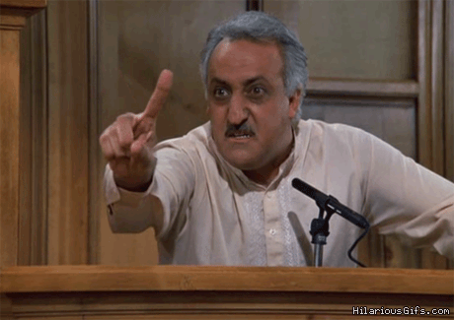
2,973,371 Tweets
2,848 Handles
Internet Research Agency
St Petersburg, Russia
Darren Linvill
Patrick Warren
FiveThirtyEight releases tweet data on July 31, 2018
Twitter deletes tweets and accounts of some known trolls
Linvill & Waren harvest, recreate, and categorize

Slide 2

Linvill & Warren Troll Categories
Left Trolls (230)
@4mysquad And so #BLM is called a "hate group" while cops sworn to serve and protect commit murder, torture, aggravated assault and theft.'
Another example of how all liberals are hateful, corrupt, lying, evil, deceitful, hypocritical, despicable pieces of s*** like @HussamA https://t.co/6E0oT6pDPp
Right Trolls (617)
Good Night Warriors! Remember White Supremacy Must be Destroyed Globally in order for True Peace & Real Justice to Reign. https://t.co/eLiMbwhD5L
RT mb141bar: Dear Lord, protect, guide, bless our President Trump. Please save us from those attempting to harm him https://t.co/mu8fHj1V50
Socially liberal messages
Primarily focused on racial identity
Often mimicked the Black Lives Matter movement
Attacked mainstream democratic politicians, particularly Hillary Clinton
Supportive of Bernie Sanders
Nativist, right-leaning populist messages
Uniformly support Donald Trump
Denigrate the Democratic party
Regularly employ “Make America Great Again” terminology
Derisive of mainstream and moderate republicans
Often with profile pictures of attractive young women
Others
Hashtag Gamer (110)
Fearmonger (122)
News Feed (54)

Slide 3
Building off Linvill and Warren’s categorization, what can we learn about :
The topics, sentiment, and emotional appeal used by Left and Right trolls in peak periods
Differences in topics, sentiment, and emotional appeal by time of day

Slide 4
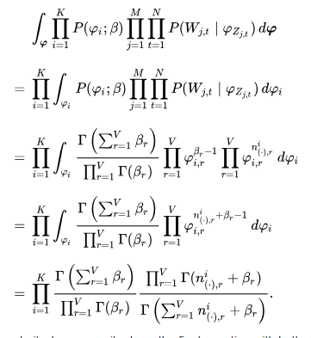
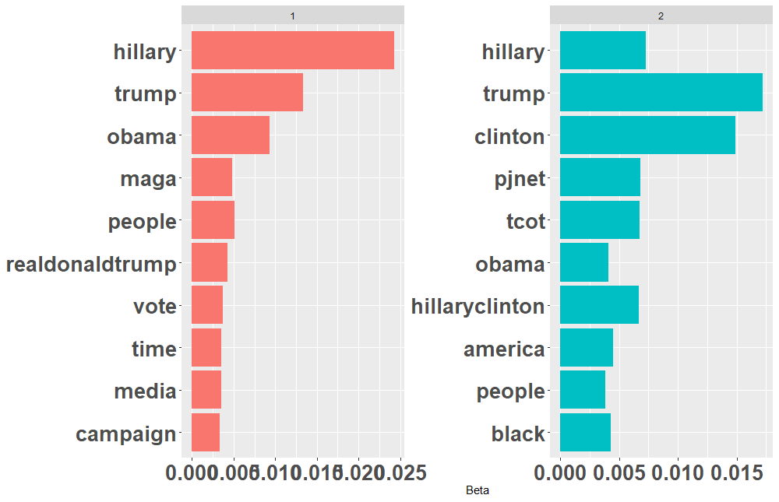

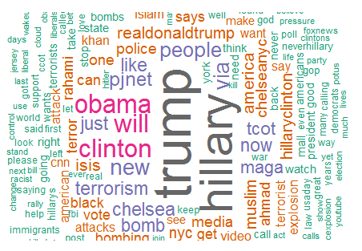
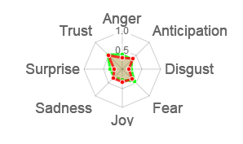
Techniques Used
Emotion
Sentiment
Right Troll
 | anger | antici-pation | disgust | fear | joy | sadness | surprise | trust |  | negative | positive
RT mb141bar: Dear Lord, protect, guide, bless our President Trump.Please save us from those attempting to harm him https://t.co/mu8fHj1V50 | 0 | 1 | 1 | 1 | 2 | 0 | 1 | 5 |  | 2 | 7
Another example of how all liberals are hateful, corrupt, lying, evil, deceitful, hypocritical, despicable pieces of s*** like @HussamA https://t.co/6E0oT6pDPp | 5 | 0 | 7 | 2 | 0 | 3 | 0 | 0 |  | 8 | 0
Sentiment
and
Emotion
(R syuzhet)
Latent Dirichlet
Allocation (LDA)
Topic 1
Topic 2
(R topicmodels)
Word Cloud
Radar Chart
(R wordcloud)
(R radarchart)

Slide 5
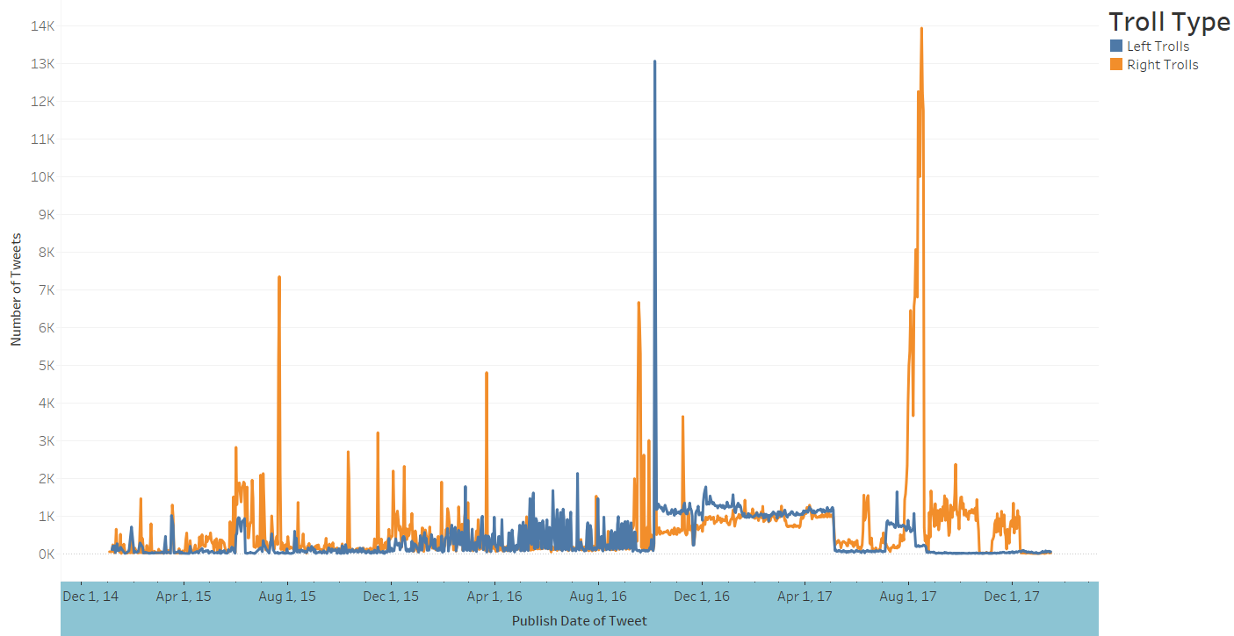
IRA Troll Tweets Dec 2014 – Dec 2018
Oct 5-8, 2016
Jul 28 – Aug 26, 2017
July 20-24, 2015
Sep 11-30, 2016
Mar 21-23, 2016

Slide 6
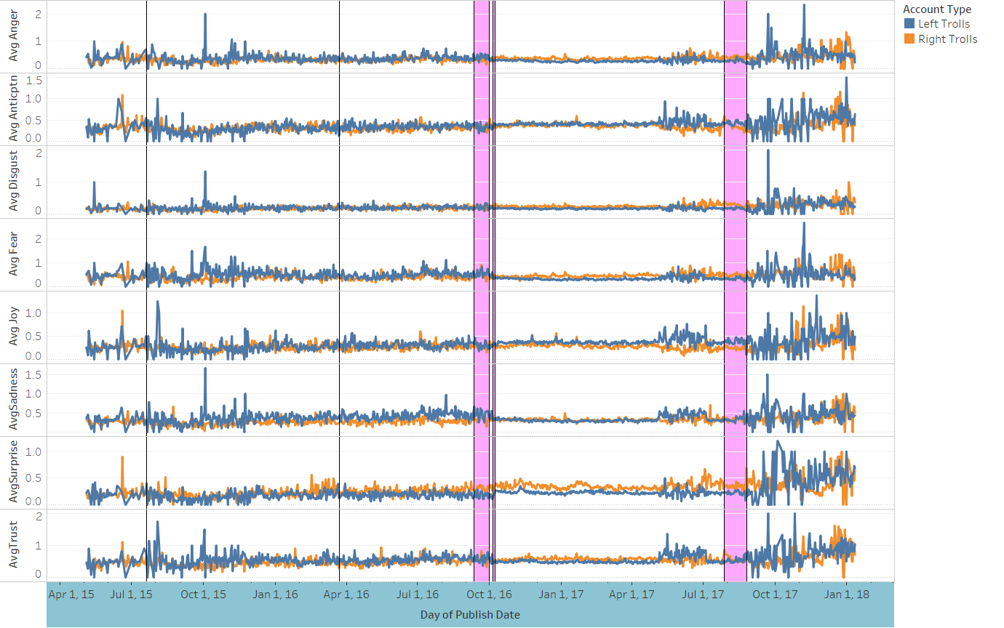
Emotion Analysis During Peak Tweet Periods
July 20-24, 2015
Mar 21-23, 2016
Sep 11-30, 2016
Oct 5-8, 2016
Jul 28 – Aug 26, 2017
Avg Anger
Avg Anticipation
Avg Disgust
Avg Fear
Avg Joy
Avg Sadness
Avg Surprise
Avg Trust

Slide 7
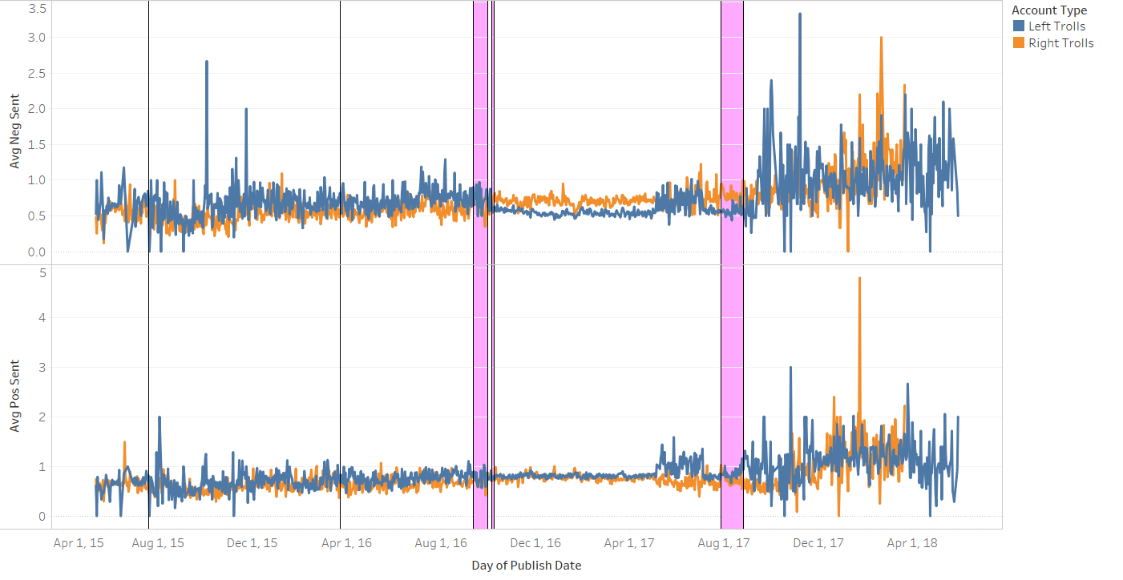
Sentiment Analysis During Peak Tweet Periods
July 20-24, 2015
Mar 21-23, 2016
Sep 11-30, 2016
Oct 5-8, 2016
Jul 28 – Aug 26, 2017
Avg Negative Sentiment
Avg Positive Sentiment

Slide 8
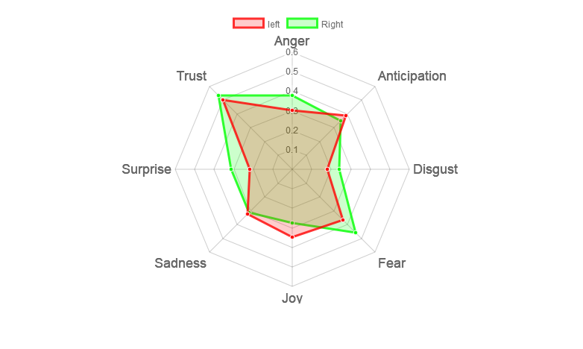
Emotion by Troll Type 2015-2017

Slide 9
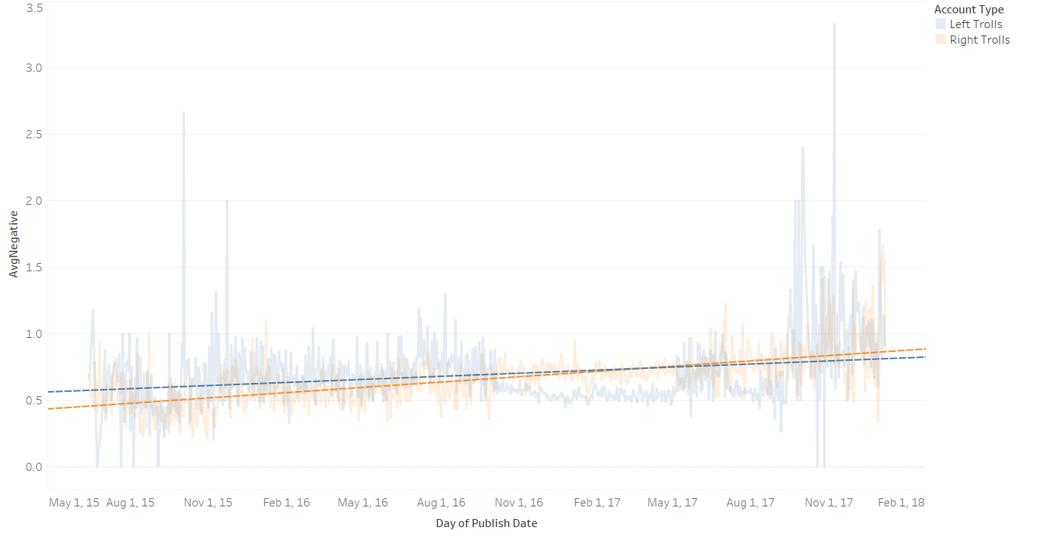
Negative Sentiment Trend 2015-2017

Slide 10
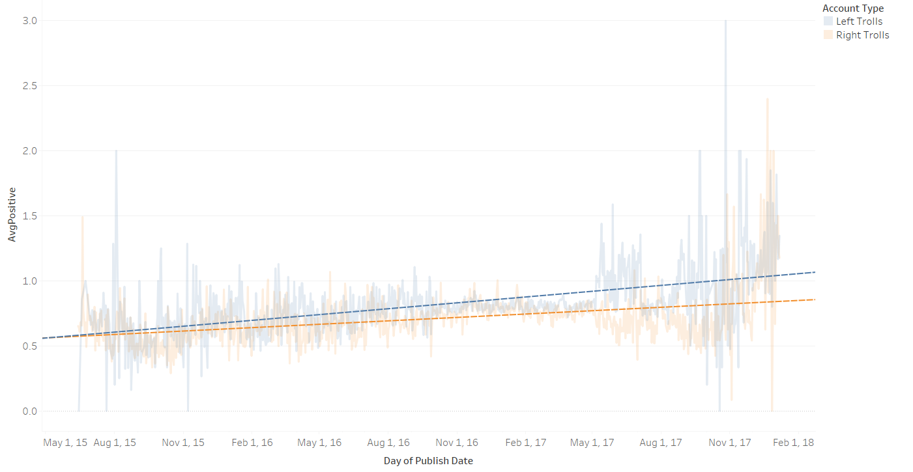
Positive Sentiment Trend 2015-2017

Slide 11
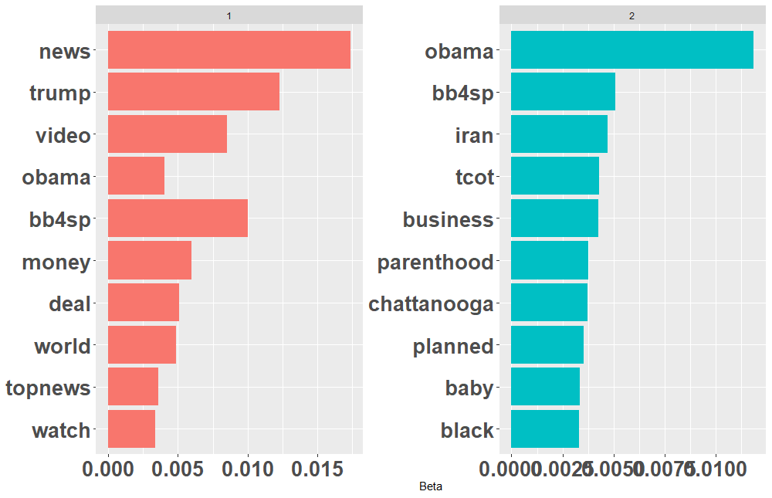
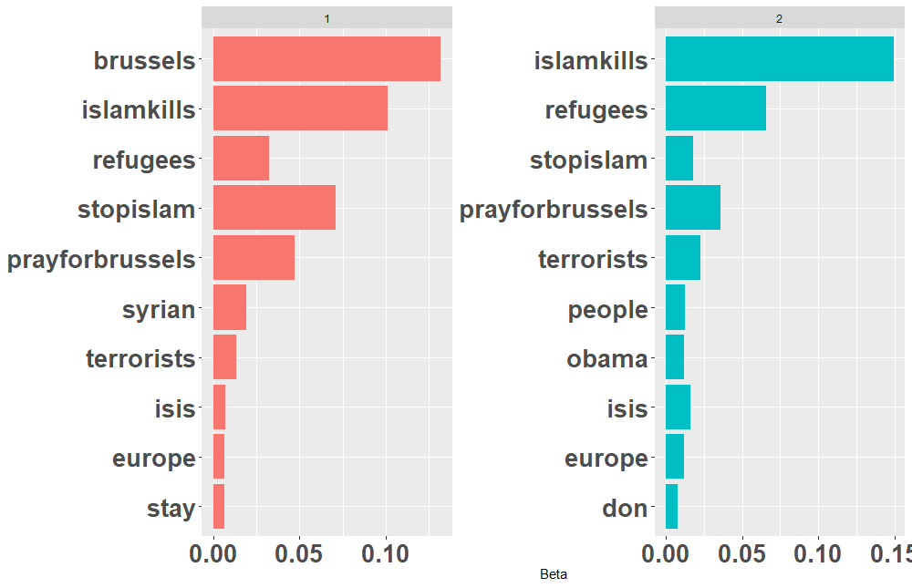
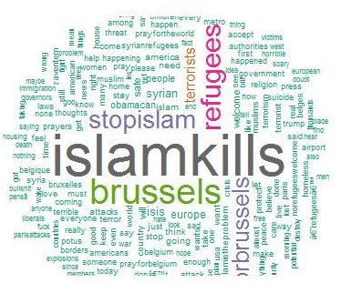
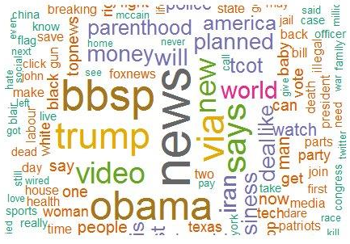
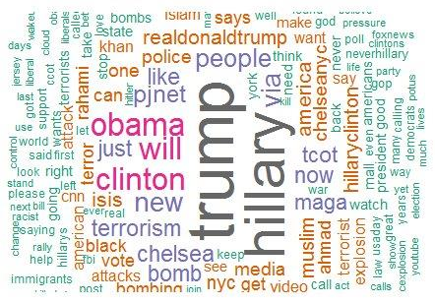
Peak Troll Tweet LDA Topic Values (Unsupervised)
July 20-24, 2015 (Right Trolls)
Mar 21-23, 2016 (Right Trolls)
Sep 11-30, 2016 (Right Trolls)
Sep 18-23, 2016 only

Slide 12
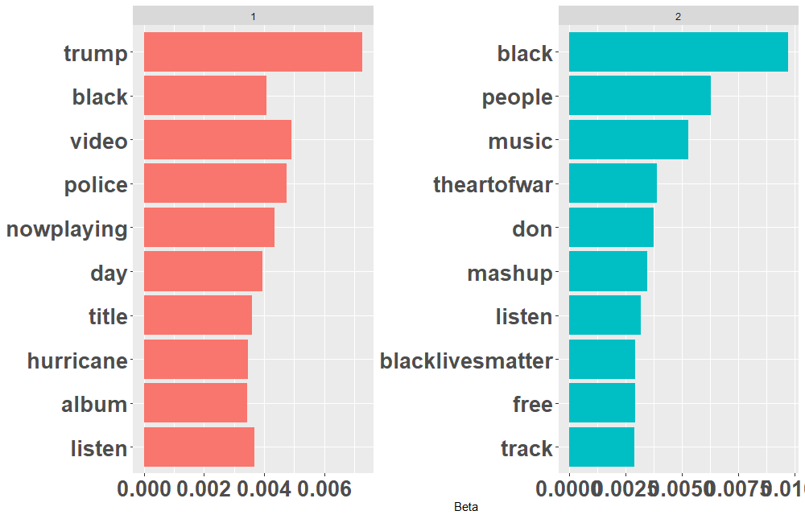
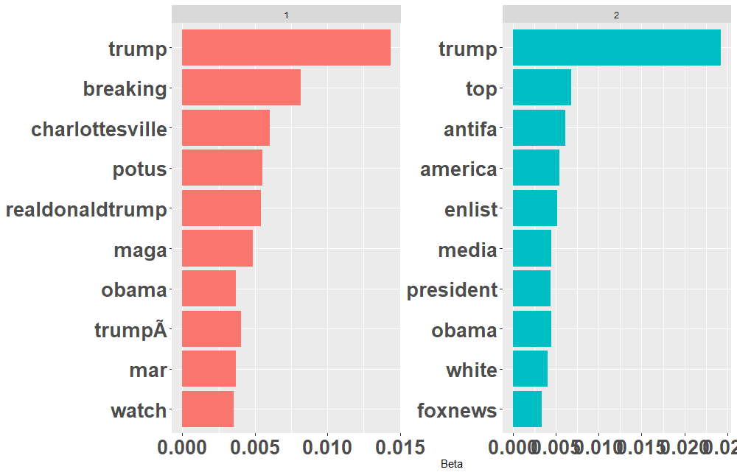
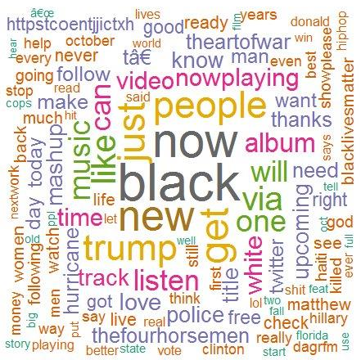
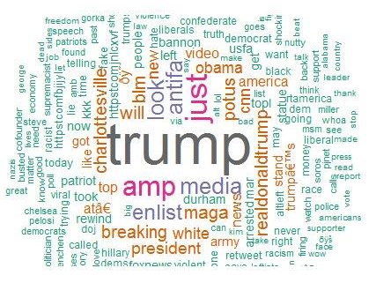
Peak Troll Tweet LDA Topic Values (Unsupervised)
Oct 5-8, 2016 (Left Trolls)
July 28 – Aug 26, 2017 (Right Trolls)
Aug, 15-16, 2017 only

Slide 13
Peak Period Tweet Analysis Findings
Total sentiment/emotion was obviously influenced the most by daily tweet volume so averages per tweet were used instead – this created its own imprecision when tweet volumes were low and no statistical correction was made for this
Differences in emotion weren’t exclusive to peak tweet periods but reflective of longer periods
Fear and Surprise emotions trended slightly higher for Right trolls while Joy trended slightly higher for Left trolls
Negative and Positive sentiment both trended up over the period, possibly indicating more extreme positions of Trolls
Positive sentiment increased at twice the rate for Left Trolls than for Right Trolls
Left Trolls started with a higher degree of negative sentiment but were overtaken by Right Trolls shortly after the Nov 2016 election
Tweets in Mar 22, 2016 around the time of terror attacks in Brussels showed strong anti-Islamic bias
Tweet topics around the Aug 11-12 Charlottesville, VA Unite the Right rally and subsequent riots were reflective of the events of that period…however there is a period of tweet volume by Right Trolls leading up to the rally date that looks suspicious and needs further investigation

Slide 14
Right Troll LDA Topic Words
2 hrs before work | morning work | lunch | afternoon work | 2 hrs after work | evening leisure | sleep
obama | obama | obama | obama | obama | obama | obama
people | people | people | people | people | people | people
pjnet | pjnet | pjnet | pjnet | pjnet | pjnet | pjnet
trump | trump | trump | trump | trump | trump | trump
hillary | hillary | hillary | hillary | hillary | hillary
america | america | america |  | america | america
don | don | don | don | don
 | realdonaldtrump | realdonaldtrump |  | realdonaldtrump | realdonaldtrump | realdonaldtrump
tcot | tcot | tcot |  | tcot |  | tcot
 | abi | abi | abi |  | abi
 | abiss | abiss | abiss |  | abiss
clinton | clinton |  |  | clinton | clinton
isis | isis |  | isis |  |  | isis
 |  |  | news | news | news | news
breaking |  |  |  | breaking | breaking
ccot |  | ccot |  |  |  | ccot
life |  | life | life
 |  |  | maga | maga |  | maga
 |  | president | president | president
time | time |  | time
accounts |  |  |  |  |  | accounts
american |  |  |  | american
 |  | day |  |  | days
 |  | enlist |  |  |  | enlist
god |  |  |  |  |  | god
 |  | gun |  |  |  | guntrust
 |  |  |  |  | iceisis | iceisis
 | love | love
 |  |  |  | remember | remember
 |  |  | rrzgbccxbo |  |  | rrzgbccxbo
 | usfa |  | usfa
 | world |  |  | world
For LDA topics found in more than one time category
Time category analysis restricted to tweets with one or more topic words in a given time category

Slide 15
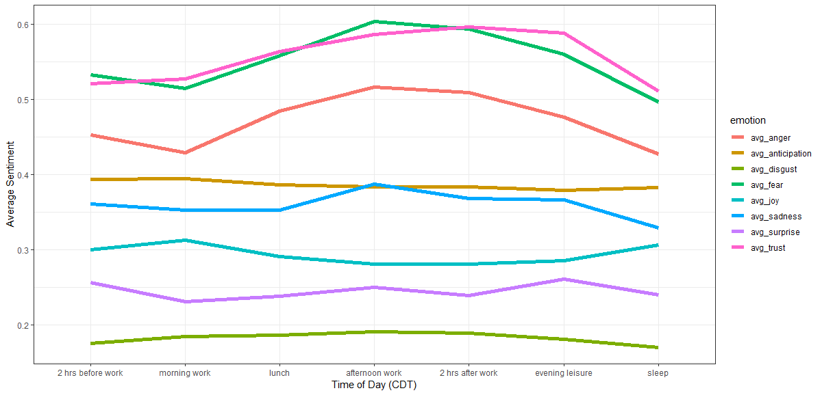
Emotional Appeal by Time of Day
Fear
Trust
Anger
Anticipation
Sadness
Joy
Surprise
Disgust

Slide 16
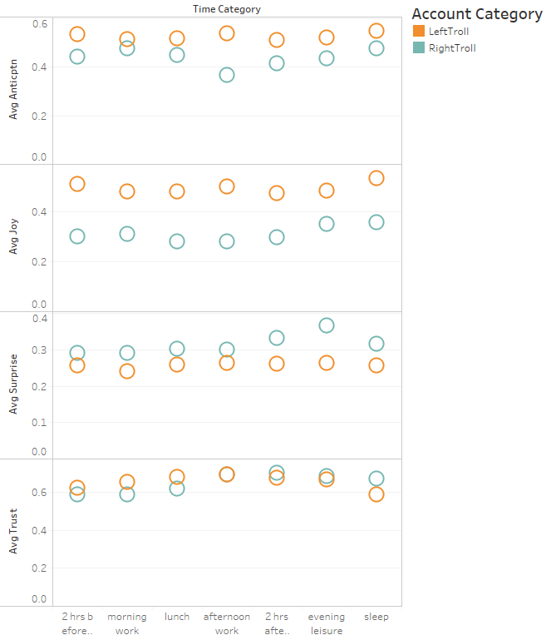
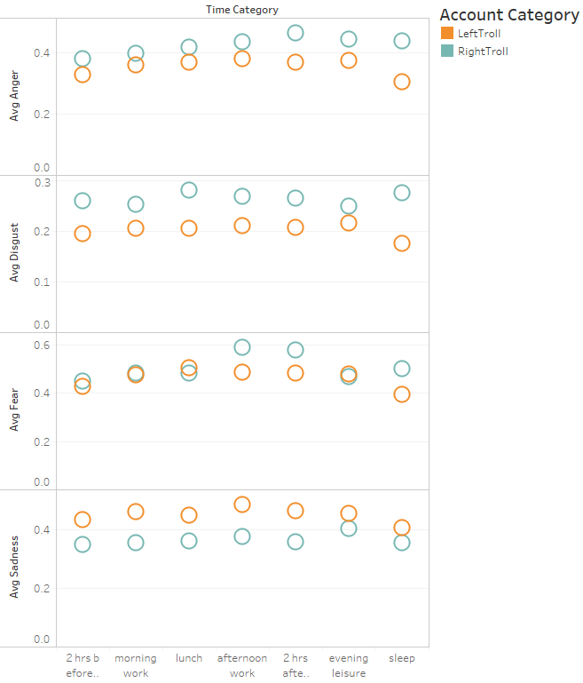
Emotional Appeal by Time of Day
Avg Anger
Avg Anticipation
Avg Disgust
Avg Joy
Avg Surprise
Avg Fear
Avg Trust
Avg Sadness

Slide 17
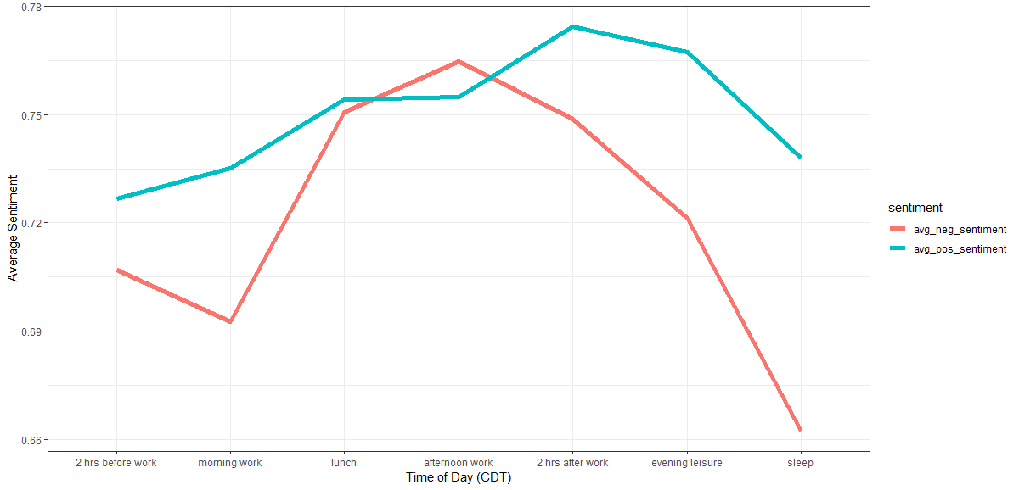
Sentiment by Time of Day
Positive
Negative

Slide 18
Time of Day Tweet Analysis Findings
Statistically, tweets exhibit greater degrees of fear, anger, and trust overall as well as in the afternoon and evening
However, it’s not obvious that tweet composition/topic/tone was intentionally changes by time of day

Slide 19
Backup

Slide 20
Sentiment & Emotion Analysis
R Syuzhet Package- implements Saif Mohammad’s NRC emotion lexicon
Emotion
Sentiment
 | anger | antici-pation | disgust | fear | joy | sadness | surprise | trust |  | negative | positive
RT mb141bar: Dear Lord, protect, guide, bless our President Trump.Please save us from those attempting to harm him https://t.co/mu8fHj1V50 | 0 | 1 | 1 | 1 | 2 | 0 | 1 | 5 |  | 2 | 7
Another example of how all liberals are hateful, corrupt, lying, evil, deceitful, hypocritical, despicable pieces of s*** like @HussamA https://t.co/6E0oT6pDPp | 5 | 0 | 7 | 2 | 0 | 3 | 0 | 0 |  | 8 | 0
Good Night Warriors! Remember White Supremacy Must be Destroyed Globally in order for True Peace & Real Justice to Reign. https://t.co/eLiMbwhD5L | 2 | 4 | 0 | 2 | 4 | 1 | 2 | 6 |  | 2 | 6
@4mysquad And so #BLM is called a "hate group" while cops sworn to serve and protect commit murder, torture, aggravated assault and theft.' | 6 | 1 | 4 | 5 | 0 | 4 | 1 | 1 |  | 7 | 1
Right
Left

Slide 21
Right Troll LDA Topic Words
2 hrs before work | morning work | lunch | afternoon work | 2 hrs after work | evening leisure | sleep
 |  |  |  |  | abcgopdebate
 |  |  |  |  | abcnews
 |  |  |  |  | antifa
 |  |  |  |  | article
 | breitbartnews
 |  |  | brussels
 |  | country
 |  |  |  | cuba
 |  |  |  |  | demdebate
 |  |  |  |  | demndebate
 |  |  |  |  | diversity
 |  |  |  | fail
 |  |  |  | fraud
florida
 | girl
gop
 |  |  |  |  | gopdebate
 |  | guns4ny
 |  |  | illegal
 |  |  |  | iran
 |  |  | islamkills
 |  |  | james
 |  |  |  |  | kill
live
 |  |  |  |  |  | opiceisis
 | permit
 | picture
 |  | prayers4california
 |  |  | refugees
rubio
 | salary
 |  |  | stand
 |  |  | stop
 |  |  | stopislam
 |  |  |  | students
 |  |  |  |  |  | targeted
 |  |  |  |  |  | targets
 |  |  |  |  | time
 |  | trumpbecause
 |  |  |  | trumpforpresident
 |  |  |  |  | vegasgopdebate
 |  |  |  | vote
 |  |  |  |  |  | wikileaks
 |  |  |  | woman
For LDA topics found in only one time category

